Slide 1
CSE 303 (Compilers)
Basic Concepts
Tasmiah Tamzid Anannya
Lecturer
Department of Computer Science and Engineering Military Institute of Science and Technology (MIST)
Mirpur Cantonment, Dhaka-1216, Bangladesh
Courtesy: Dr. Muhammad Masroor Ali, Professor, BUET

Slide 2

Introduction
Programming languages are notations for describing computations to people and to machines.
The world as we know it depends on programming languages, because all the software running on all the computers was written in some programming language.
But, before a program can be run, it first must be translated into a form in which it can be executed by a computer.
The software systems that do this translation are called compilers.
Basically, compiler is a language processing system.

Slide 3
Introduction
Programming languages are notations for describing computations to people and to machines.
The world as we know it depends on programming languages, because all the software running on all the computers was written in some programming language.
But, before a program can be run, it first must be translated into a form in which it can be executed by a computer.
The software systems that do this translation are called compilers.
Basically, compiler is a language processing system.

Slide 4
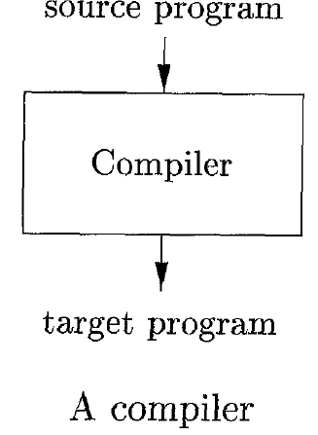
Language Processors- Compilers
A compiler is a program that can read a program in one language: the source language and translate it into an equivalent program in another language - the target language.
An important role of the compiler is to report any errors in the source program that it detects during the translation process.

Slide 5
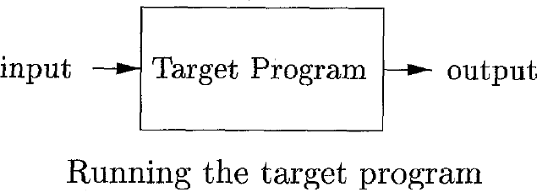
Language Processors- Compilers
If the target program is an executable machine-language program, it can then be called by the user to process inputs and produce outputs.

Slide 6
Language Processors- Compilers
After executing a C program file:
hello.c → source code
hello.o → object file; contains function definitions in binary form hello.exe → linker/ executable file; links together a number of object files to produce a binary file which can be directly executed
C language uses compiler

Slide 7
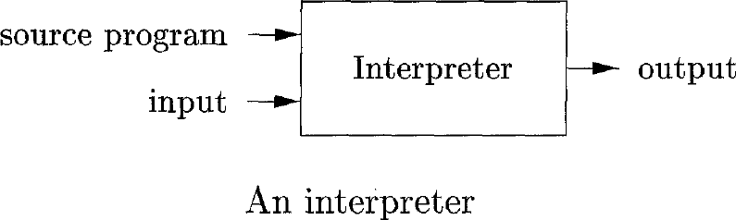
Language Processors — Interpreter
An interpreter is another common kind of language processor.
Instead of producing a target program as a translation, an interpreter appears to directly execute the operations specified in the source program on inputs supplied by the user.

Slide 8
Language Processors — Interpreter
After executing a python program file:
hello.py → source code
hello.pyc → interpreted to bytecode; bytecode is executed by
software called a virtual machine (VM)
Python language does not use compilers.

Slide 9
Compiler vs Interpreter
Compiler works in two steps:
Step 1:
Step 2:
Interpreter works in one step:
Step 1:
Error message
Source code
Compiler
Target code
Translation process
input
Target code
output
Execution process
input
Interpreter
output
Source code
6 / 34

Slide 10
Compiler vs Interpreter
Compiler will scan the program at once and translate the whole program, interpreter will translate one by one statement.
Compiler creates intermediate code, whereas interpreter does not.
Thus compiler will require more memory to store the intermediate code.
The machine-language target program produced by a compiler is usually much faster than an interpreter at mapping inputs to outputs.
An interpreter, however, can usually give better error diagnostics than a compiler, because it executes the source program statement by statement.
6 / 34

Slide 11
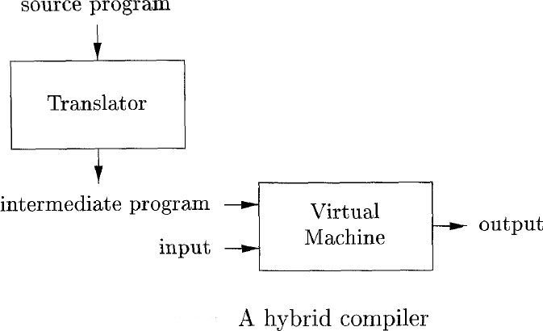
Hybrid Compiler
Example
Java language processors combine compilation and interpretation.

Slide 12
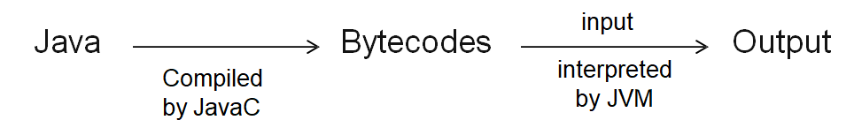
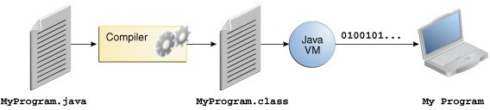
Hybrid Compiler
Java language processors combine compilation and interpretation (hybrid compiler)

Slide 13
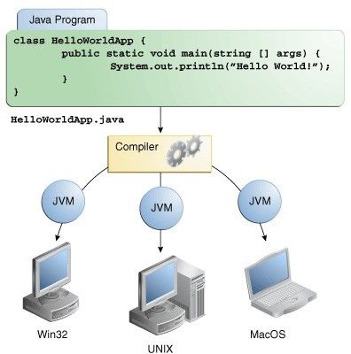
Hybrid Compiler
Benefit: bytecodes compiled on one machine can be interpreted in another machine

Slide 14
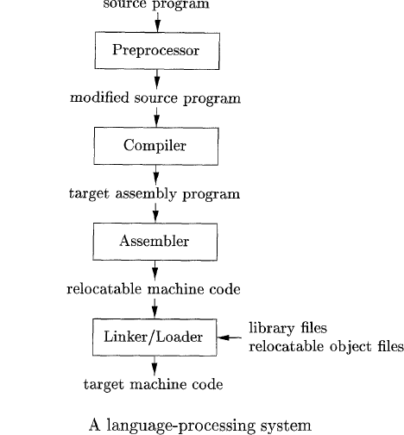
Language Processors — continued
In addition to a compiler, several other programs may be required.
The task of collecting the source program is sometimes entrusted to a separate program, called a preprocessor.
Preprocessor removes #include with substitute file- file inclusion
Also does macro expansion

Slide 15
Language Processors — continued
The modified source program is then fed to a compiler.
The compiler may produce an assembly-language program as its output, because assembly language is easier to produce as output and is easier to debug.
The assembly language is then processed by a program called an assembler that produces relocatable machine code as its output.
Machine dependent
Can load the code
at any point
in the main memory

Slide 16
Language Processors — continued
Necessity of Linker and Loader
Large programs are often compiled in pieces, so the relocatable machine code may have to be linked together with other relocatable object files and library files into the code that actually runs on the machine.
The linker resolves external memory addresses, where the code in one file may refer to a location in another file.
The loader then puts together all of the executable object files into memory for execution.

Slide 17
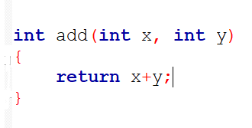
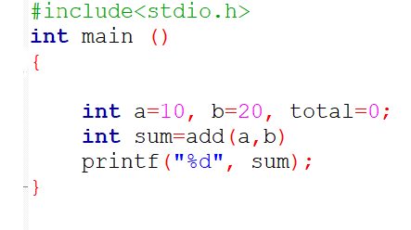
Example- job of a linker
first.c
second.c

Slide 18
The Structure of a Compiler
To translate text from one language to another, the tool must understand both the form or syntax, and content or meaning of the input language.
Two parts of compiler: Analysis & Synthesis
Analysis (Front end): checks for syntactic or semantic error; provide error message; stores information of source code in symbol table.
Synthesis (Back end): Constructs target program from Intermediate code and symbol table.
Connecting the front end and the back end, it has a formal structure for representing the program in an intermediate form whose meaning is largely independent of either language.

Slide 19
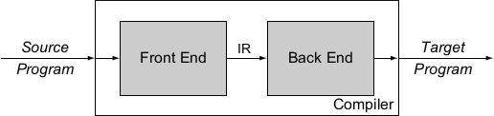
The Structure of a Compiler

Slide 20
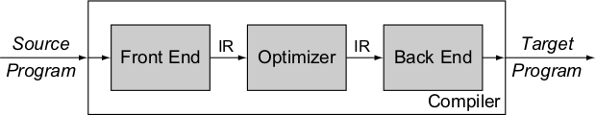
The Structure of a Compiler

Slide 21
The Structure of a Compiler
Up to this point we have treated a compiler as a single box that maps a source program into a semantically equivalent target program.

Slide 22
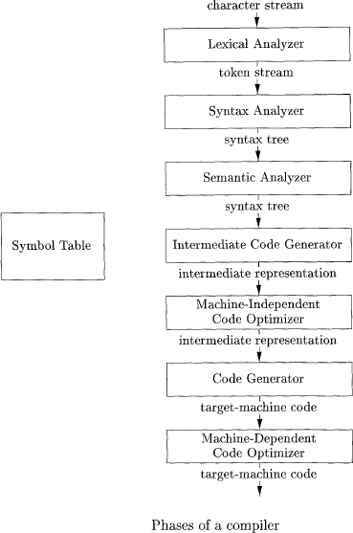
The analysis part breaks up the source program into constituent pieces and imposes a grammatical structure on them.
It then uses this structure to create an intermediate representation of the source program.
If the analysis part detects that the source program is either syntactically ill formed or semantically unsound, then it must provide informative messages, so the user can take corrective action.

Slide 23
The analysis part also collects information about the source program and stores it in a data structure called a symbol table,
The synthesis part constructs the desired target program from the intermediate representation and the information in the symbol table.

Slide 24
The symbol table, which stores information about the entire source program, is used by all phases of the compiler.

Slide 25
Machine independent
front end/ analysis part
Some compilers have a machine-independent optimization phase between the front end and the back end.
Since optimization is optional, one or the other of the two optimization phases shown may be missing.
Machine dependent
Back end/ synthesis part

Slide 26
Symbol Table
To store the name of all entities in a structured form at one place
To verify if a variable has been declared
To determine the scope of a variable
To implement type checking

Slide 27

Lexical Analysis
The first phase of a compiler is called lexical analysis or scanning.

Slide 28
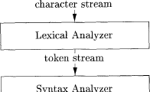
Lexical Analysis — continued
The lexical analyzer reads the stream of characters making up the source program and groups the characters into meaningful sequences called lexemes.

Slide 29
Lexical Analysis — continued
For each lexeme, the lexical analyzer produces as output a token of the form
<token-name, attribute-value>
that it passes on to the subsequent phase, syntax analysis.
In the token, the first component token-name is an abstract symbol that is used during syntax analysis, and the second component attribute-value points to an entry in the symbol table for this token.

Slide 30
Lexical Analysis — continued
<token-name, attribute-value>
position = initial + rate ∗ 60
We consider a source program that contains the assignment statement
position = initial + rate * 60
The characters in this assignment could be grouped into the lexemes and mapped into the tokens passed on to the syntax analyzer

Slide 31
Lexical Analysis — continued
(token-name, attribute-value)
position = initial + rate ∗ 60
1. position is a lexeme that would be mapped into a token
<id, 1>.
id is an abstract symbol standing for identifier,
1 points to the symbol-table entry for position, The symbol-table entry for an identifier holds information about the identifier, such as its name and type.

Slide 32
Lexical Analysis — continued
(token-name, attribute-value)
position = initial + rate ∗ 60
2.The assignment symbol = is a lexeme that is mapped into the token <=>.
Since this token needs no attribute-value, we have omitted the second component.
We could have used any abstract symbol such as assign for the token-name, but for notational convenience we have chosen to use the lexeme itself as the name of the abstract symbol.

Slide 33
Lexical Analysis — continued
(token-name, attribute-value)
position = initial + rate ∗ 60
3. initial is a lexeme that is mapped into the token <id,2>,
2 points to the symbol-table entry for initial.

Slide 34
Lexical Analysis — continued
(token-name, attribute-value) REPEAT
position = initial + rate ∗ 60
3. initial is a lexeme that is mapped into the token <id,2>,
2 points to the symbol-table entry for initial.

Slide 35
Lexical Analysis — continued
(token-name, attribute-value)
position = initial + rate ∗ 60
4. + is a lexeme that is mapped into the token <+>.

Slide 36
Lexical Analysis — continued
(token-name, attribute-value)
position = initial + rate ∗ 60
5. rate is a lexeme that is mapped into the token <id, 3>, where 3 points to the symbol-table entry for rate.

Slide 37
Lexical Analysis — continued
(token-name, attribute-value)
position = initial + rate ∗ 60
6. * is a lexeme that is mapped into the token <∗>.

Slide 38
Lexical Analysis — continued
(token-name, attribute-value)
position = initial + rate ∗ 60
7. 60 is a lexeme that is mapped into the token <60>.

Slide 39
Lexical Analysis — continued
(token-name, attribute-value)
position = initial + rate ∗ 60
Blanks separating the lexemes would be discarded by the lexical analyzer.

Slide 40
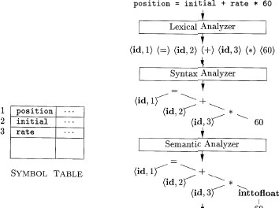
Lexical Analysis — continued
position = initial + rate ∗ 60
Figure shows the representation of the assignment statement after lexical analysis as the sequence of tokens,
<id, 1> <=> <id, 2> <+> <id, 3> <∗><60>
In this representation, the token names =, +, and * are abstract symbols for the assignment, addition, and multiplication operators, respectively.

Slide 41
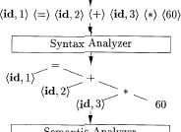
Syntax Analysis
The second phase of the compiler is syntax analysis or parsing.
The parser uses the first components of the tokens produced by the lexical analyzer to create a tree-like intermediate representation that depicts the grammatical structure of the token stream.

Slide 42
Syntax Analysis
A typical representation is a syntax tree in which each interior node represents an operation and the children of the node represent the arguments of the operation.

Slide 43
Syntax Analysis
This tree shows the order in which the operations in the assignment position = initial + rate * 60
are to be performed.

Slide 44
Syntax Analysis
The tree has an interior node labeled * with <id, 3> as its left child and the integer 60 as its right child. The node <id, 3> represents the identifier rate.
The node labeled * makes it explicit that we must first multiply the value of rate by 60.

Slide 45
Syntax Analysis
The node labeled + indicates that we must add the result of this multiplication to the value of initial.

Slide 46
Syntax Analysis
The root of the tree, labeled =, indicates that we must store the result of this addition into the location for the identifier position.

Slide 47
Syntax Analysis
This ordering of operations is consistent with the usual conventions of arithmetic which tell us that multiplication has higher precedence than addition, and hence that the multiplication is to be performed before the addition.

Slide 48
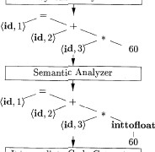
Semantic Analysis
The semantic analyzer uses the syntax tree and the information in the symbol table to check the source program for semantic consistency with the language definition.
It also gathers type information and saves it in either the syntax tree or the symbol table, for subsequent use during intermediate-code generation.

Slide 49
Semantic Analysis
An important part of semantic analysis is type checking, where the compiler checks that each operator has matching operands.
For example, many programming language definitions require an array index to be an integer.
The compiler must report an error if a floating-point number is used to index an array.

Slide 50
Semantic Analysis
The language specification may permit some type conversions called coercions.
For example, a binary arithmetic operator may be applied to either a pair of integers or to a pair of floating-point numbers.
If the operator is applied to a
floating-point number and an integer, the compiler may convert or coerce the integer into a floating-point number.

Slide 51
Semantic Analysis
Suppose that position, initial, and rate have been declared to be floating-point numbers, and that the lexeme 60 by itself forms an integer.
The type checker in the semantic analyzer discovers that the operator * is applied to a floating-point number rate and an integer 60.
In this case, the integer may be converted into a floating-point number.

Slide 52
Semantic Analysis
Notice that the output of the semantic analyzer has an extra node for the operator inttofloat, which explicitly converts its integer argument into a floating-point number.

Slide 53
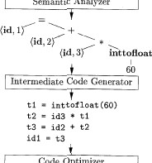
Intermediate Code Generation
In the process of translating a source program into target code, a compiler may construct one or more intermediate representations, which can have a variety of forms.
Syntax trees are a form of intermediate representation.
They are commonly used during syntax and semantic analysis.

Slide 54
Intermediate Code Generation
After syntax and semantic analysis of the source program, many compilers generate an explicit low-level or machine-like intermediate representation, which we can think of as a program for an abstract machine.
This intermediate representation should have two important properties:
it should be easy to produce
it should be easy to translate into the target machine.

Slide 55
Intermediate Code Generation
We consider an intermediate form called “three-address code”.
Like the assembly language for a machine in which every memory location can act like a register.
Three-address code consists of a sequence of instructions, each of which has at most three operands.

Slide 56
t1 = inttofloat(60) t2 = id3 * t1
t3 = id2 + t2 id1 = t3
Intermediate Code Generation

Slide 57
Intermediate Code Generation
Each three-address instruction has at most one operator in addition to the assignment.
Has to decide on the order in which operations are to be done.
Multiplication precedes the addition in the source program.
Must generate a temporary name to hold the value computed by each instruction.
Some “three-address” instructions have fewer than three operands.

Slide 58
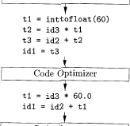
Code Optimization
The machine-independent
code-optimization phase attempts to improve the intermediate code so that better target code will result.
Usually better means faster, shorter code, or target code that consumes less power.

Slide 59
Code Optimization
So the optimizer can transform the code into the shorter sequence,
t1 = id3 * 60.0 id1 = id2 + t1

Slide 60
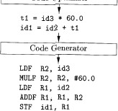
Code Generation
The code generator takes as input an intermediate representation of the source program and maps it into the target language.
If the target language is machine code, registers or memory locations are selected for each of the variables used by the program.
A crucial aspect of code generation is the judicious assignment of registers to hold variables.

Slide 61
Code Generation
For example, using registers R1 and R2, the intermediate code might get translated into the machine code
LDF R2, id3
MULF R2, R2, #60.0
LDF Rl, id2 ADDF Rl, Rl, R2
STF idl, Rl

Slide 62

Symbol-Table Management
An essential function of a compiler is to record the variable names used in the source program and collect information about various attributes of each name.

Slide 63
Symbol-Table Management
These attributes may provide information about the storage allocated for a name, its type, its scope (where in the program its value may be used)
In the case of procedure names, such things as the number and types of its arguments, the method of passing each argument (for example, by value or by reference), and the type returned.

Slide 64
The Grouping of Phases into Passes
The discussion of phases deals with the logical organization of a compiler.
In an implementation, activities from several phases may be grouped together into a pass that reads an input file and writes an output file.
For example, the front-end phases of lexical analysis, syntax analysis, semantic analysis, and intermediate code generation might be grouped together into one pass.
Code optimization might be an optional pass.
Then there could be a back-end pass consisting of code generation for a particular target machine.

Slide 65
The Grouping of Phases into Passes
The discussion of phases deals with the logical organization of a compiler.
In an implementation, activities from several phases may be grouped together into a pass that reads an input file and writes an output file.
For example, the front-end phases of lexical analysis, syntax analysis, semantic analysis, and intermediate code generation might be grouped together into one pass.
Code optimization might be an optional pass.
Then there could be a back-end pass consisting of code generation for a particular target machine.

Slide 66
The Grouping of Phases into Passes — continued
Some compiler collections have been created around carefully designed intermediate representations that allow the front end for a particular language to interface with the back end for a certain target machine.
With these collections, we can produce compilers for different source languages for one target machine by combining different front ends with the back end for that target machine.
Similarly, we can produce compilers for different target machines, by combining a front end with back ends for different target machines.

Slide 67
The Grouping of Phases into Passes — continued
Some compiler collections have been created around carefully designed intermediate representations that allow the front end for a particular language to interface with the back end for a certain target machine.
With these collections, we can produce compilers for different source languages for one target machine by combining different front ends with the back end for that target machine.
Similarly, we can produce compilers for different target machines, by combining a front end with back ends for different target machines.
CSE 303 (Compilers)

Slide 68
The Grouping of Phases into Passes — continued
Some compiler collections have been created around carefully designed intermediate representations that allow the front end for a particular language to interface with the back end for a certain target machine.
With these collections, we can produce compilers for different source languages for one target machine by combining different front ends with the back end for that target machine.
Similarly, we can produce compilers for different target machines, by combining a front end with back ends for different target machines.

Slide 69
Compiler-Construction Tools
The compiler writer, like any software developer, can profitably use modern software development environments containing tools such as language editors, debuggers, version managers, profilers, test harnesses, and so on.
In addition to these general software-development tools, other more specialized tools have been created to help implement various phases of a compiler.

Slide 70
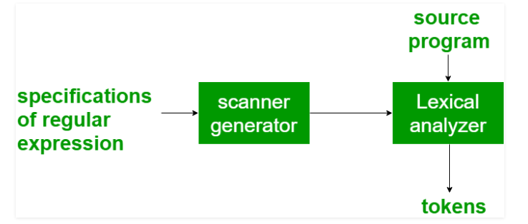
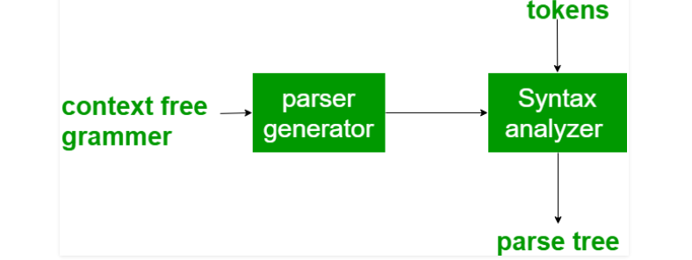
1. Scanner generators - produce lexical analyzers from a regular-expression description of the tokens of a language. Example: Lex 2. Parser generators - It produces syntax analyzers (parsers) from the input that is based on a grammatical description of programming language or on a context-free grammar. Example: PIC, EQM
Compiler-Construction Tools

Slide 71
3. Syntax directed translation engines – It generates intermediate code with three address format from the input that consists of a parse tree. These engines have routines to traverse the parse tree and then produces the intermediate code. 4. Data-flow analysis engines – It is used in code optimization. Data flow analysis is a key part of the code optimization that gathers the information, that is the values that flow from one part of a program to another. 5. Automatic code generators – It generates the code generator to create machine language for a target machine. Each operation of the intermediate language is translated using a collection of rules and then is taken as an input by the code generator. 6. Compiler construction toolkits – provide an integrated set of routines for constructing various phases of a compiler. .
Compiler-Construction Tools
Annotated
parse tree
Syntax Directed Translation Engines
Intermediate
code

Slide 72

Thank You

